Slide 1
Containerized infrastructure
Author: Arthur Asatryan
Email: biacoder@gmail.com
GitHub: https://github.com/Biacode

Slide 2

What is the container?

Slide 3
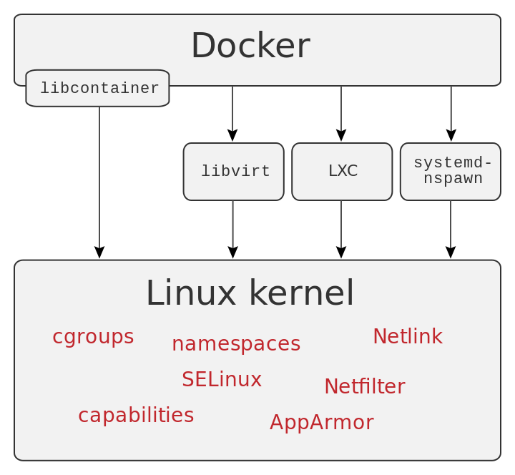
How it works?

Slide 4
Advantages
Containers are:
Immutable
Lightweight
Fast
Containers are not:
Virtual machines
No need static allocation

Slide 5
Disadvantages
Relatively new technology / practice
Not “easy” to migrate from legacy
Sticky with linux kernel (thanks GOD :D)

Slide 6
Best practices
Don’t store data in containers
Don’t create large images
Don’t use a single layer image
Don’t create images from running containers
Don’t use only the “latest” tag
Don’t run more than one process in a single container
Don’t store credentials in the image. Use environment variables
Don’t run processes as a root user
Don’t rely on IP addresses

Slide 7

Wrong approach

Slide 8
Wrong approach

Slide 9

The right approach

Slide 10
The right approach

Slide 11
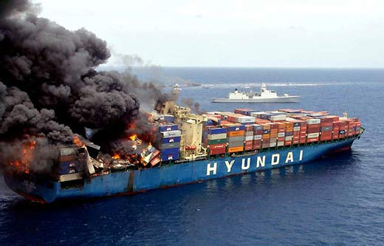
When containers count are grow

Slide 12

Marshaller

Slide 13

Load balancing

Slide 14
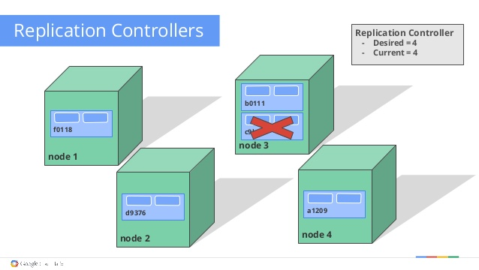
Replication

Slide 15

Auto scaling

Slide 16
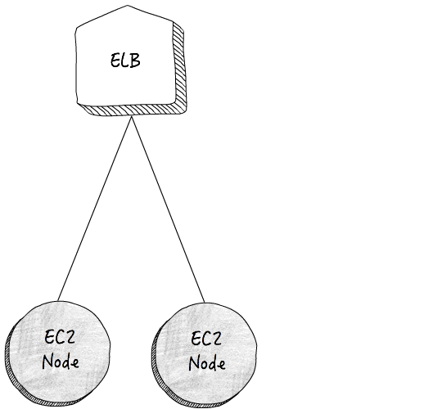
Rolling updates

Slide 17
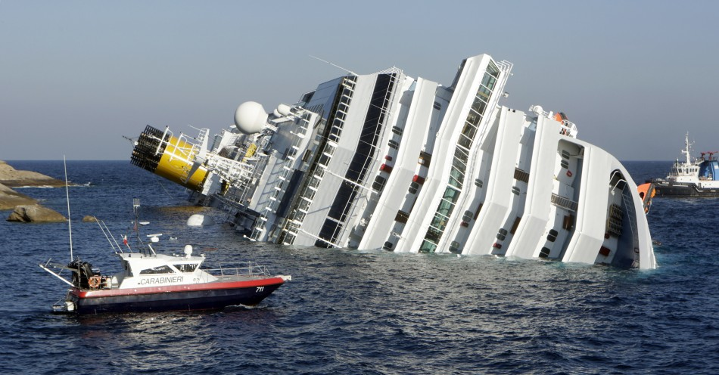
Health checks

Slide 18
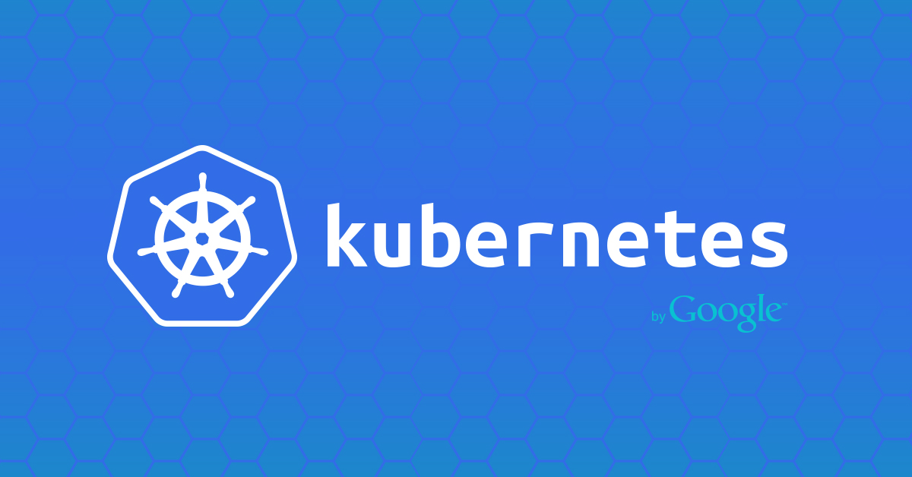
Kubernetes

Slide 19

It was pain

Slide 20
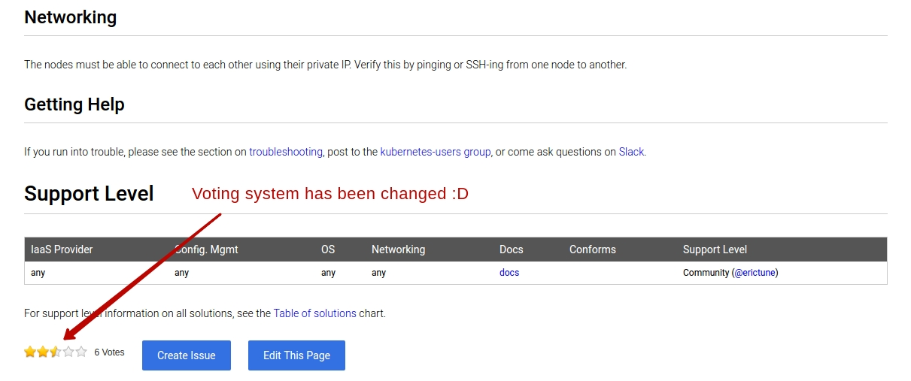
Retarded documentation

Slide 21
CD process

Slide 22
Microservices architecture example

Slide 23
Example
Bamboo configuration examples

